Slide 1
L09.01 Single source shortest path algorithm
50.004 Introduction to Algorithm
Dr. Simon LUI
ISTD, SUTD

Slide 2
Outline
Single source shortest path problem
Relaxation
The Bellman-Ford algorithm

Slide 3
Definition - weighted path in graph
Given:
A directed graph
A weight function
A path p:
The weight of a path
Notes:
I must specify a path to get the total length, uniquely defined

Slide 4
Shortest-paths problems
The weight of the shortest-path from u to v
a
2
5
s
c
2
-1
6
6
b
Notes:
Shortest distance from s: a value of a node: node likes to know his shortest path value and his predecessor node
The oracle knows the value of δ and its justification (the path)
Why is good to remember the previous node? a breadcrumb tree…
Multiple shortest paths

Slide 5
Shortest-paths problems
Weight (“length”) of shortest-path from u to v
a
2
5
s
c
2
-1
6
6
b
(For a given source s) Each node v likes to know
(i) his shortest path distance δ(v), ii) his predecessor node v.π
Notes:
Shortest distance from s: a value of a node: node likes to know his shortest path value and his predecessor node
The oracle knows the value of δ and its justification (the path)
Why is good to remember the previous node? a breadcrumb tree…
Multiple shortest paths

Slide 6
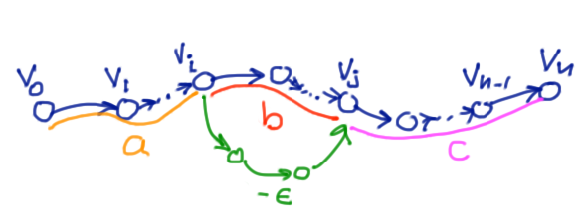
Important property
Sub-paths of shortest paths are also shortest paths
Proof: if
sub-path v₀ to v_{j} is not optimal but v₀ to v_{n} is optimal
Then a shorter path from v₀ to v_{j} can improve v₀ to v_{n}
….CONTRADICATION!

Slide 7
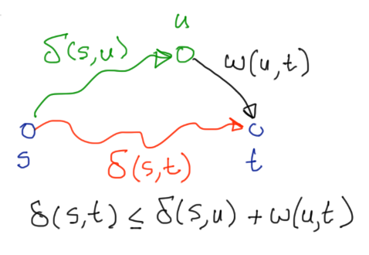
Triangle inequality
Notes:
If I knew the delta of my pre then I can find my delta
Hence I need iterations to find a fixed point: where we all agree!

Slide 8
Triangle inequality
Notes:
If I knew the delta of my pre then I can find my delta
Hence I need iterations to find a fixed point: where we all agree!

Slide 9
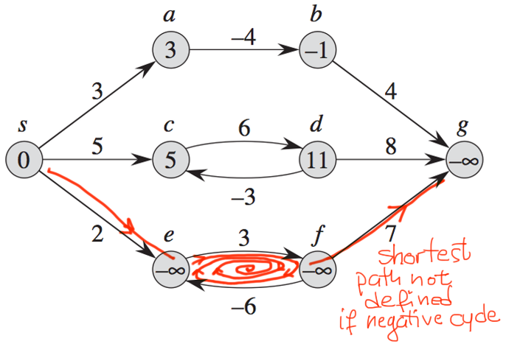
Negative weight edges, negative and positive cycle
Negative cycle: If negative cycle exists, shortest path cannot be defined.
Positive cycle: It never exists in any shortest path.

Slide 10
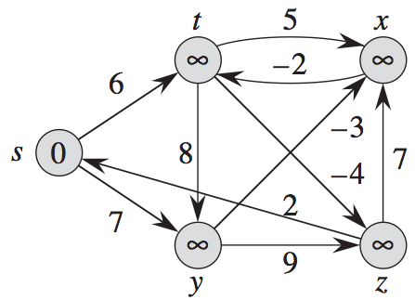
Questions
Notes:
Lets try to understand what is a negative cycle, And also try to find shortest paths. Is this easy?
Forget number inside node

Slide 11
Questions
Notes:
Lets try to understand what is a negative cycle, And also try to find shortest paths. Is this easy?

Slide 12
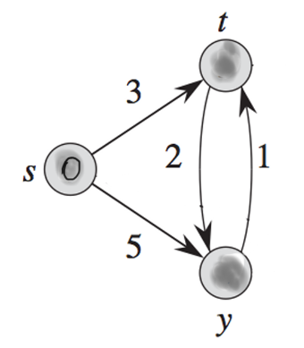
Optimal path characterization
How can we “characterize” the optimal
paths from s, and the value δ?
Can we write some equations to solve?
Example: δ(t) and δ(y)
δ(t)
δ(s)=0
1
δ(y)
Notes:
What kind of equations can we write for the value function δ?
Can we relate δ(x) to the δ of other nodes?
De we care for outgoing edges?
Write equations: add variables to nodes (predecessors), weights to edges. Write the equations.
The triangle inequality
There must be equality for some predecessor

Slide 13
Triangle inequality
δ(t)
δ(s)=0
1
δ(y)
The shortest path length values must satisfy these equations:
How do we solve the equations? by iterations
Notes:
If I knew the delta of my pre then I can find my delta
Hence I need iterations to find a fixed point: where we all agree!
Have the students write that

Slide 14
How do we solve the equations?
-> By iterations starting conservatively
Think of nodes as sending to their
neighbors their estimate from the
previous round
δ(t)
δ(s)=0
1
δ(y)
Notes:
What kind of equations can we write for the value function δ?
Can we relate δ(x) to the δ of other nodes?
De we care for outgoing edges?
Write equations: add variables to nodes (predecessors), weights to edges. Write the equations.
The triangle inequality
There must be equality for some predecessor

Slide 15
How do we solve the equations?
-> By iterations starting conservatively
Iterations (time = 0, 1, 2…)
Each node decides on its predecessor
δ(t)
δ(s)=0
1
 | time=0 | 1 | 2 | 3
δ(s) | 0 | 0 | 0 | 0
δ(t) | ∞ | 3 | 3 | 3
δ(y) | ∞ | 5 | 4 | 4
δ(y)
Notes:
What kind of equations can we write for the value function δ?
Can we relate δ(x) to the δ of other nodes?
De we care for outgoing edges?
Write equations: add variables to nodes (predecessors), weights to edges. Write the equations.
The triangle inequality
There must be equality for some predecessor

Slide 16
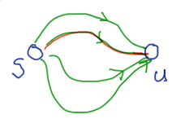
Equations for shortest paths
Assume DGs with no negative cycles
Initial state = s
Proposition 1: δ(s,u) is:

Slide 17
Equations for shortest paths
Proposition 2: δ(s,v) satisfies the Bellman equations
The solution of each equations is unique
Notes:
How do I find v.π? just check the equations
Obviously unique since optimal path distance = unique definition

Slide 18
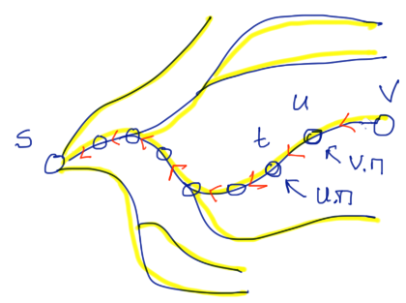
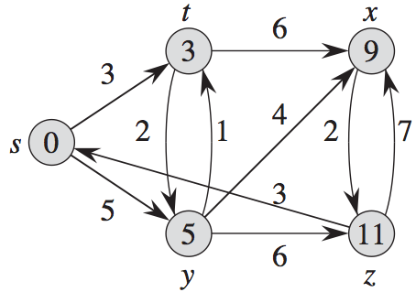
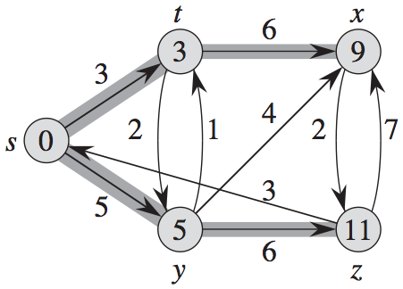
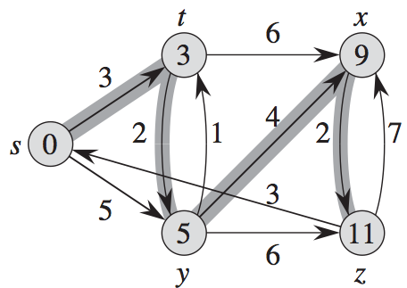
Proposition 3:
δ(s,v) defines a tree structure over V:
the shortest-path tree
(not necessarily unique)
two possible shortest path trees
but the value function is unique
Notes:
I guessed the value function

Slide 19
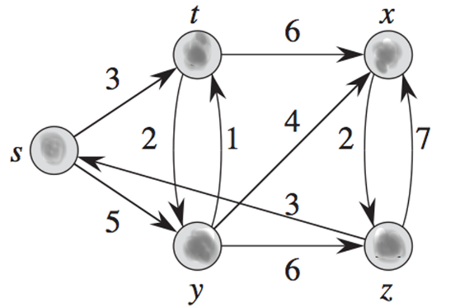
Question
write the Bellman equations for the DG
for the shortest paths from s

Slide 20
Solving the Bellman equations (for a given source s)
Problem: How can we compute the values that satisfy the Bellman equations?
Notes:
Unique: because each solution defines a tree of paths that realize the value function. If at a node we get two different values, then

Slide 21
Solving the Bellman equations
For each node
receives the shortest distance estimates from neighbors, picks the predecessor that can minimize its shortest distance
sends its updates to its neighbors
Equilibrium: no more improvements are possible
Proposition: Starting with a conservative estimates, improve the estimate of the shortest distance of each node using “relaxations”
Cost: number of relaxations we need to perform
Notes:
Proof depends on computation model,

Slide 22
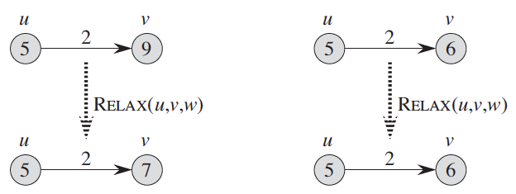
Relaxations
Relaxing an edge (u,v): test if we can improve the shortest path to v (with the value that we found so far), by going through u
Notes:
Why is this a key property? can one guess Bellman Ford now?

Slide 23
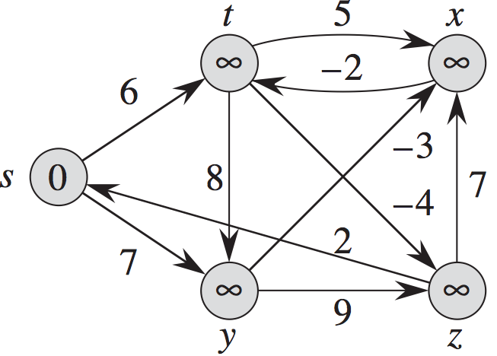
Iterations using relaxations
6
6
X
X
X
2
14
Edges that successfully relaxed are red
Notes:
How many relaxations we need

Slide 24
Relaxing edges along the shortest paths
Under “safe” conditions, relaxing only once the edges along a shortest path in the right order gives us the value of δ along the path
Notes:
these edges are red

Slide 25
Using relaxations to obtain the Shortest Paths (SP)
How many (successful) relaxations can take place?
At least: |V|-1 but in the right order (choose the relaxations along the shortest path tree, from root to leaves)
At most: exponential in the number of edges |V|
SP algorithms (Bellman-Ford, Dijkstra): smart choice of relaxations

Slide 26
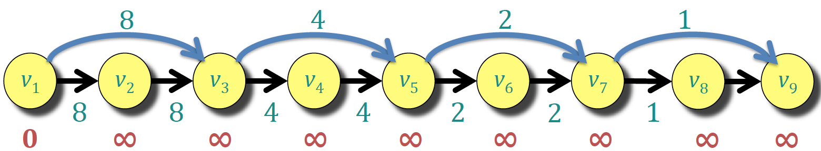
Example with exponential number of possible relaxations
1
8 16 20 24 26 28 29 30
29
26 27 28
27
20 22 24 25 26
25
22 23 24
23
8 12 16 18 20 21 22
21
18 19 20
19
12 14 16 17 18
17
14 15 16
15

Slide 27
Our basic convergence theorem
Theorem:
Assumption: we start “safe” with
We keep performing (successful) edge relaxations if available
Eventually we will converge at each node after finitely many steps to the actual value of the shortest distance, i.e..,

Slide 28
Our basic convergence theorem
Proof:
(a) Every time we relax an edge, we reduce at least by some d>0 (same d for all relaxations)
(b) We never go below
(c) If we there are no more possible relaxations, we have the (unique) solution

Slide 29
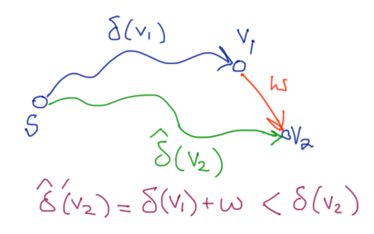
Our basic convergence theorem
Proof:
(a) Every time we relax an edge, we reduce at least by some d>0 (same d for all relaxations)
For every update, is a difference of the lengths of 2 paths from s to v.

Slide 30
Our basic convergence theorem
Proof:
(b) We never go below

Slide 31
Our basic convergence theorem
Proof:
(c) If we there are no more possible relaxations, we have the (unique) solution
If no more relaxations possible, then we satisfy the Bellman equations, and since is their unique solution, we have found it!
If (a),(b),(c) hold, the proof follows by contradiction: suppose that the theorem does not hold. Then we must violate some of (a),(b),(c).

Slide 32
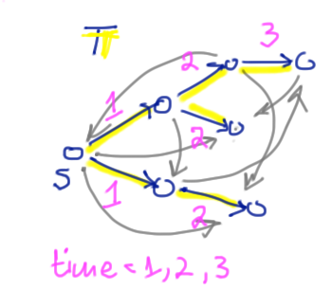
Bellman-Ford
for v in V:
v.d = ∞ initialization
v.π = nil
s.d = 0
do n-1 times:
for each edge (u,v) in E: main loop
relax (u,v)
for each edge (u,v) in E:
if v.d > u.d+ w(u,v):
report a negative cycle & return negative cycle detection
report no negative cycles
Θ(|V|)
Complexity: Θ(|V||E|)
Θ(|V|³): dense graphs
Θ(|V|²): sparse graphs
Θ(|V||E|)
Θ(|E|)
Property: if no negative cycles, then at termination for all v: v.d = δ(s,v)
Notes:
Why the complexity is VE?

Slide 33
Bellman Ford - relaxation
relax (u,v): if distance[u] + w(u,v) < distance[v]:
distance[v] := distance[u] + w(u,v)
predecessor[v] := u

Slide 34
Bellman-Ford
Make sure that all edges along the SP tree at level k are relaxed at least once after the edges of level k-1
To guarantee that, it relaxes all edges of the graph enough times (as many as the maximum tree depth, i.e., |V|)
At the and, if no equilibrium is reached => negative cycle

Slide 35
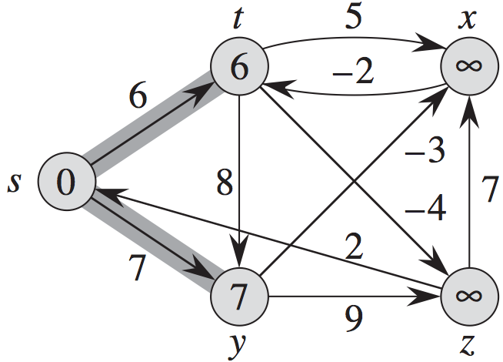
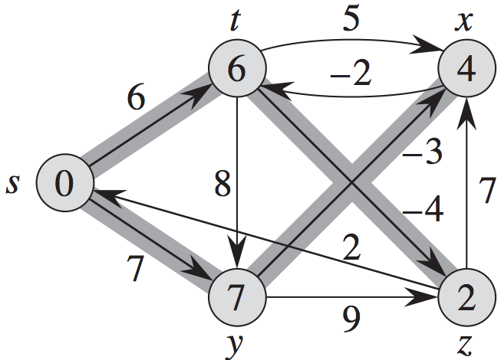
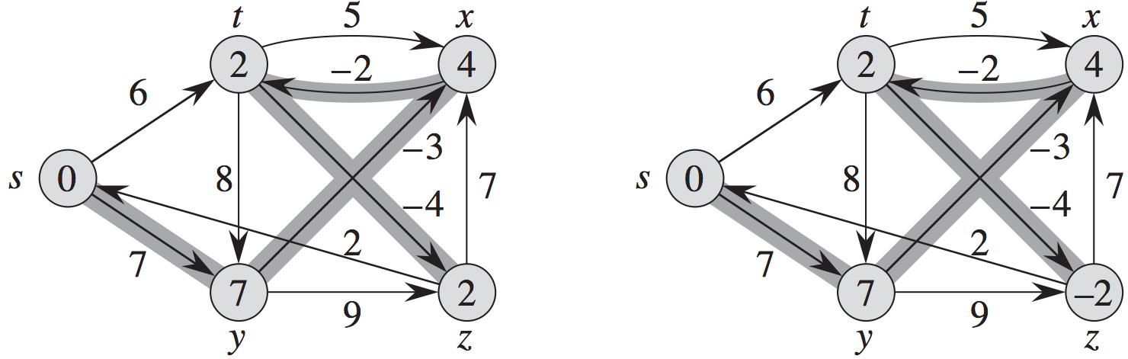
Bellman-Ford example

Slide 36
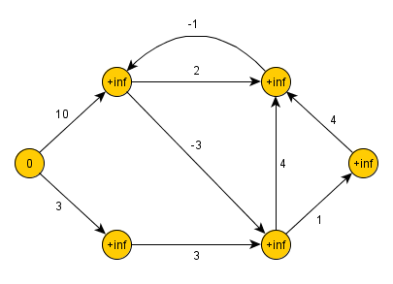
Exercise

Slide 37
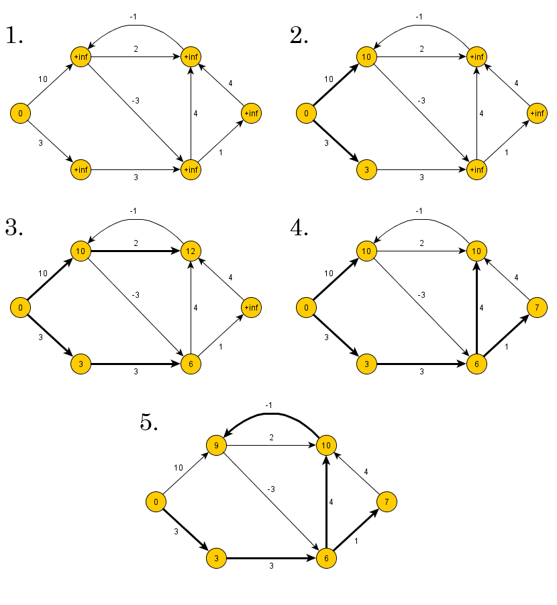
Answer

Slide 38
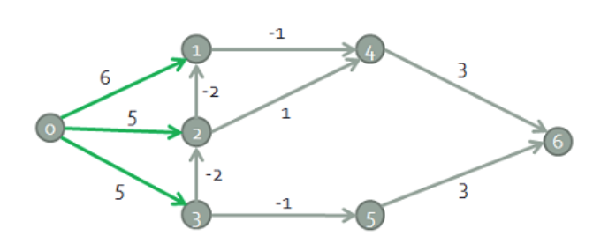
Example 2
Find the shortest path from node 0

Slide 39
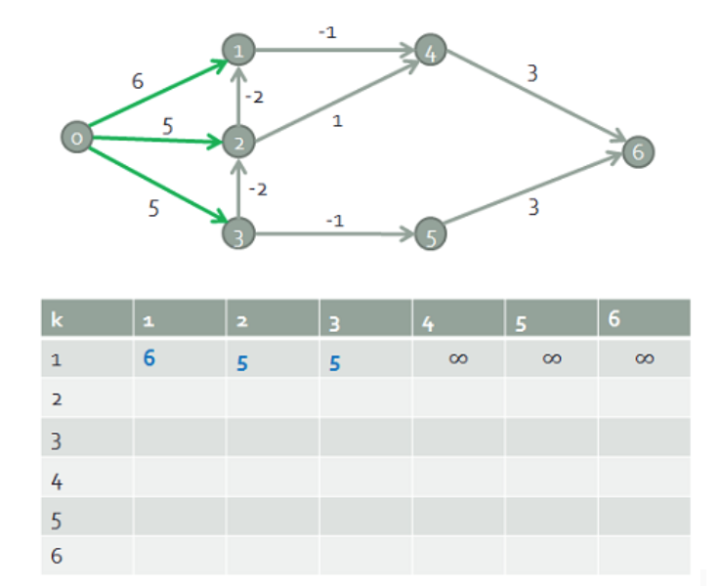
Example 2 Answer
6
5
5

Slide 40
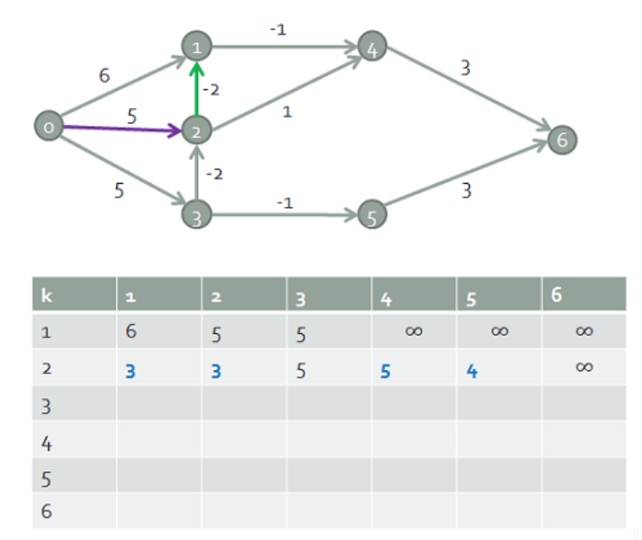
Example 2 Answer
3
5
3
5
4

Slide 41
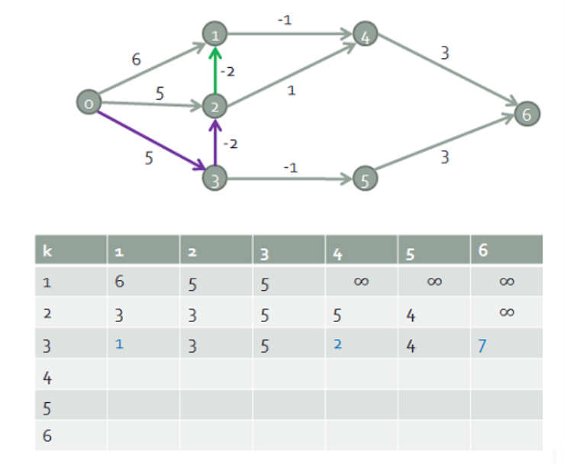
Example 2 Answer
1
2
3
7
5
4

Slide 42
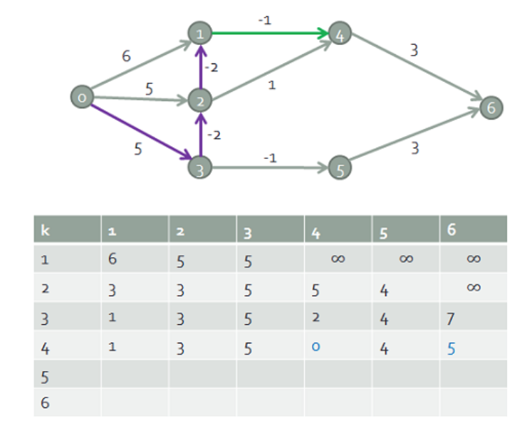
Example 2 Answer
1
0
3
5
5
4

Slide 43
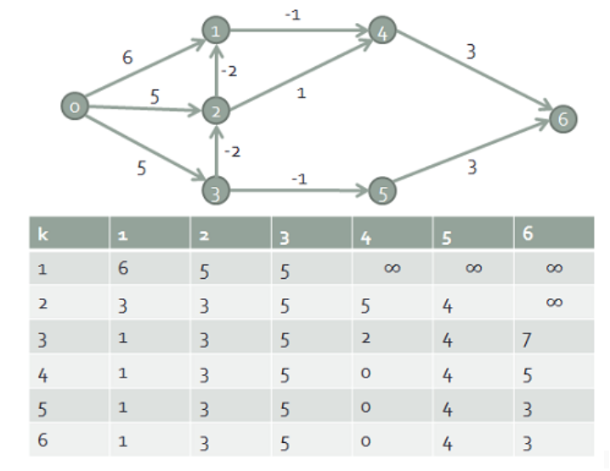
Example 2 Answer
1
0
3
3
5
4

Slide 44
Conclusions
The “value function” (weight of shortest path) at each node satisfy the Bellman equations (triangle inequality)
These are sets of inequalities with at least one equality per node, and can be solved by iterations starting from some conservative estimate
An equivalent iterative method is based on edge relaxations
If we could guess the shortest path tree, then |V|-1 relaxations could lead to the solution of the value function
We must be smart how we choose the relaxations because there can be exponentially many possible
Bellman-Ford algorithm: chooses relaxations in a “worse case” fashion and has complexity Θ(nm)

